Slide 1


Radio frequency remote controlled wireless robot
PROJECT NO:0895
SUPERVISOR:NURAN DOĞRU
STUDENT: SÜLEYMAN SARI

Slide 2
INTRODUCTION
What is the purpose of the project ?
Expression of the project.
Flow chart.
Equipment’s list.
How it’s made ?
Ports and connections.
Software Codes.
Vehicle Info
Test Video
Gantt chart.
Prices.
Conclusion
References

Slide 3

WHAT IS THE PURPOSE?

Slide 4
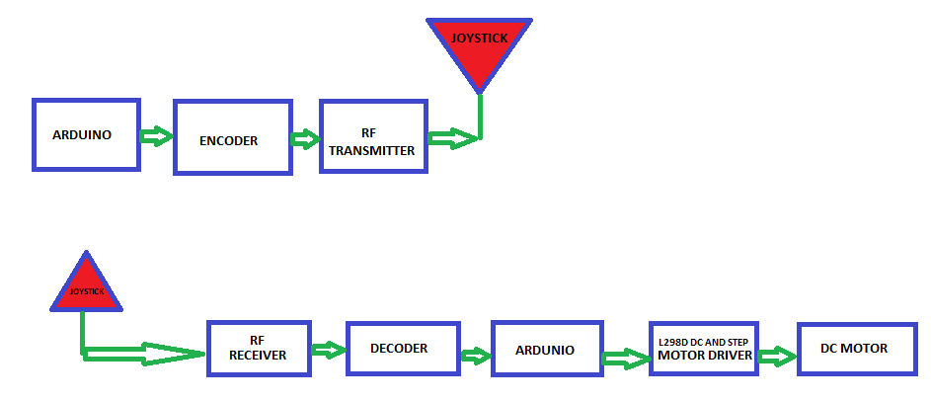
EXPRESSION OF THE PROJECT AND FLOW CHART

Slide 5
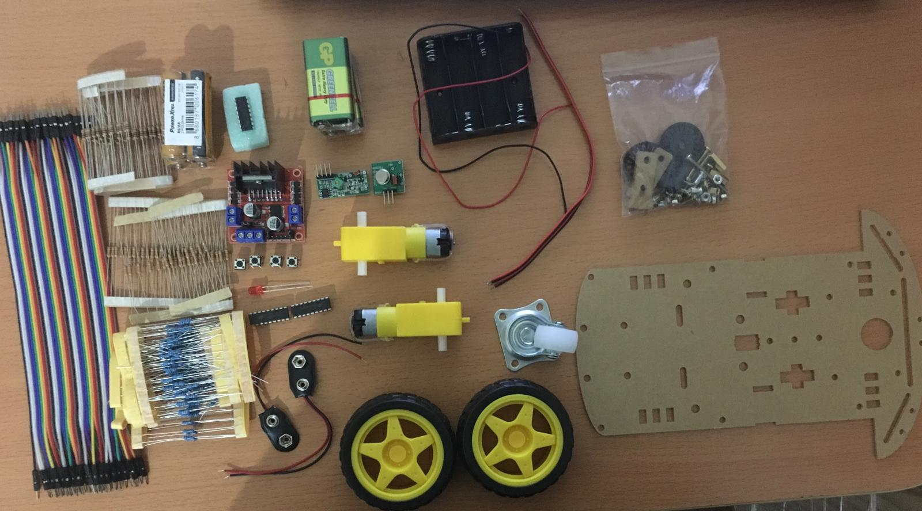
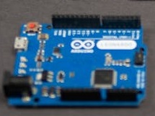
MATERIALS AND TOOLS
Components Required for Transmitter Circuit
434 MHz RF Transmitter Module
Arduino UNO
Powerbank
Joystick x 2
Antenna
Jumper Wires
Components Required for Receiver Circuit
434 MHz RF Receiver Module
Arduino UNO
Motor Driver Module
Small Geared Motor x 2
9V Battery x 2
Robot Chassis
Jumper Wires

Slide 6
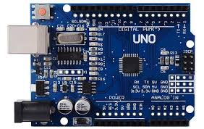
MATERIALS
ARDUİNO UNO SİNGLE-BOARD : With Arduino Uno, you can get physical information from various sensors, and you can do various experiments with this information. You can also get an output from stimuli such as motor, LED. A basic programming knowledge is sufficient to control such electronic components by connecting them to the Arduino Uno board.

Slide 7
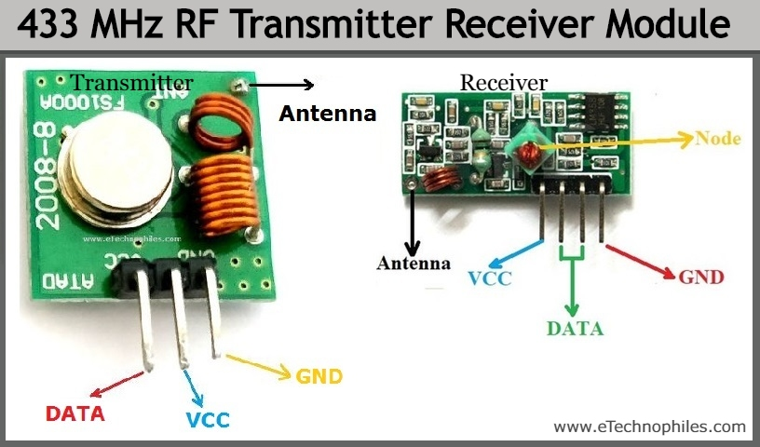
RF Transmitter and Receiver

Slide 8
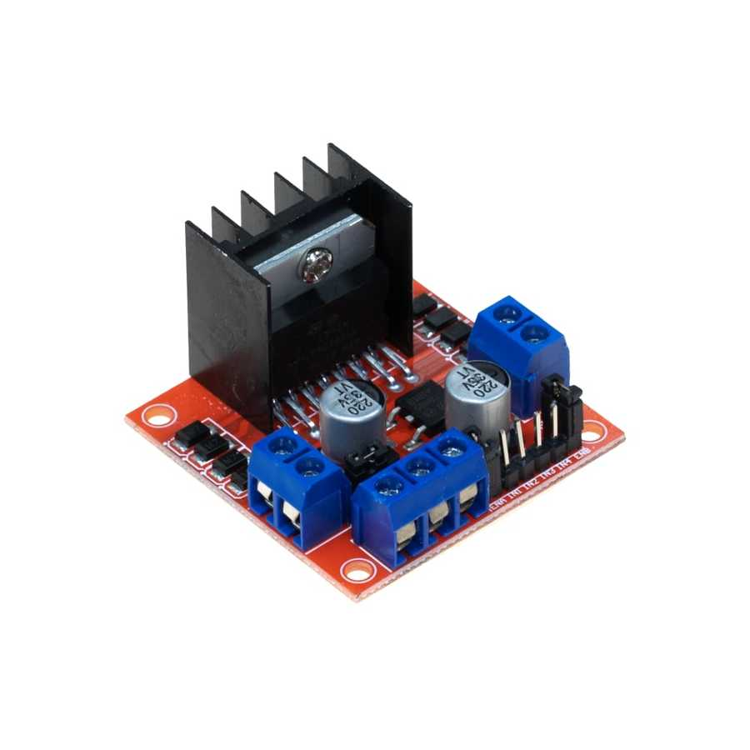
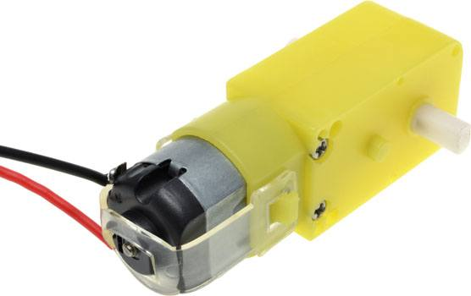
Motor Drıver Module
The Motor Driver is a module for motors that allows you to control the working speed and direction of two motors simultaneously .
DC MOTOR : DC motor is any of a class of rotary electrical motors that converts direct current electrical

Slide 9
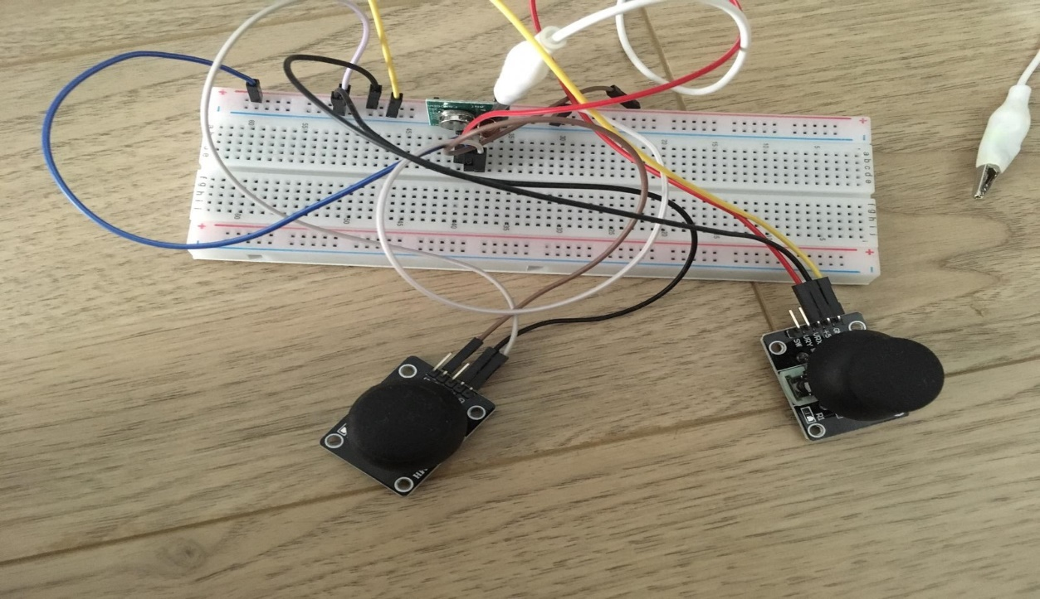
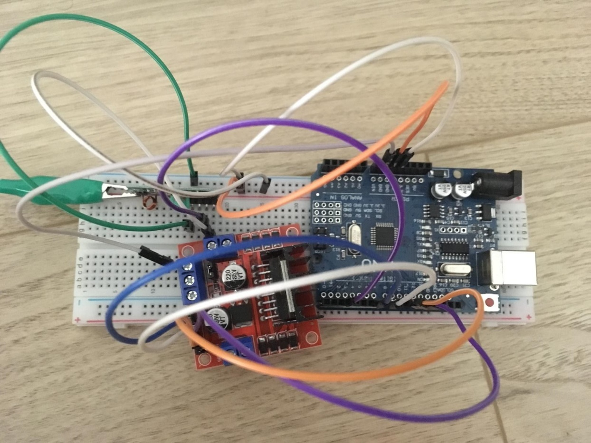
HOW IT’S MADE ?

Slide 10
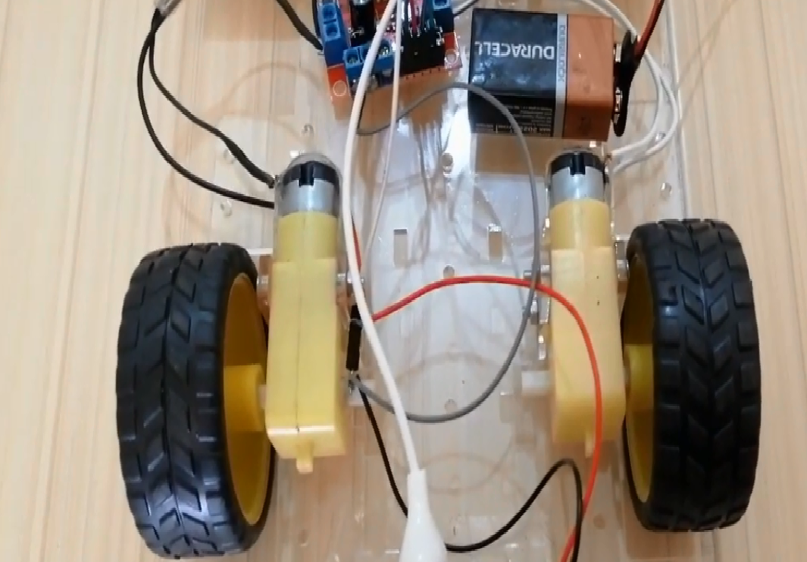
HOW IT’S MADE ?

Slide 11
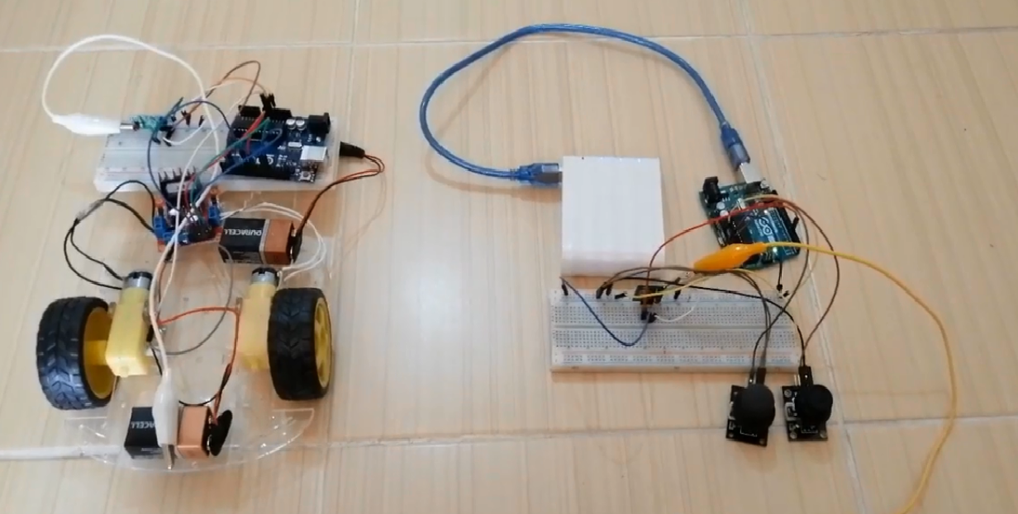
HOW IT’S MADE ?

Slide 12
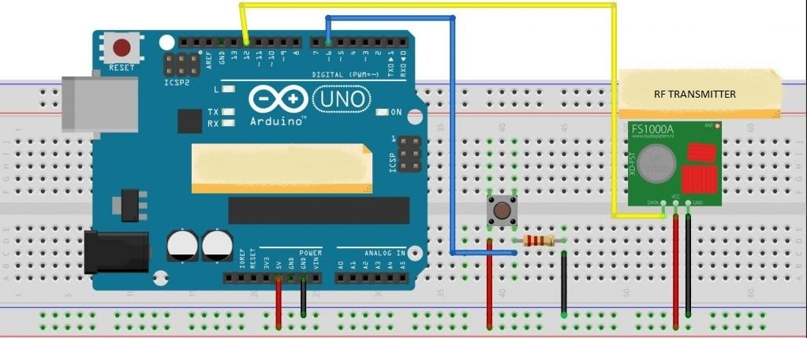
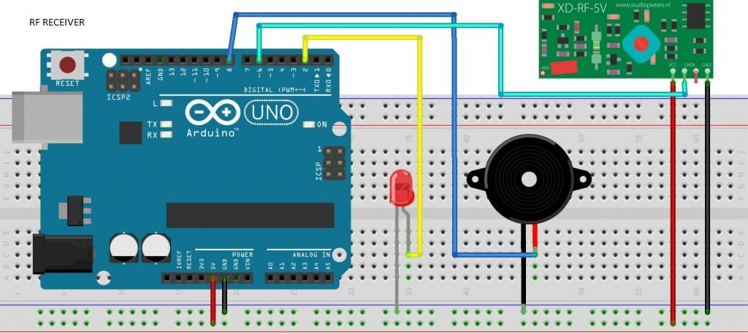
PORTS AND CONNECTIONS

Slide 13
SOFTWARE
TRANSMITTER MODULE SOURCE CODE
#include <VirtualWire.h> // VirtualWire Library
int TX_PIN = 5;// Transmitter data pin that connects to the Arduino.
It must have a PWM pin.
int TX_ID = 3; // Transmitter ID.In order to be recognized by the buyer.
int joy_x_value=0;
int joy_y_value=0;
typedef struct data// Structure has been defined. The data to be sent is defined here.
{
int TX_ID;
int joystick_x;
int joystick_y;
};

Slide 14
void setup() {
pinMode(A0,INPUT);
pinMode(A1,INPUT);
Serial.begin(9600);
vw_setup(4000);// Setup is done for communication and communication starts. It can be set to a maximum of 4000 kbps. vw_set_tx_pin(TX_PIN);// Define where the data leg is connected.
}
void loop()
{
joy_x_value=analogRead(A0);
joy_y_value=analogRead(A1);
joy_x_value=map(joy_x_deger,0,1023,0,255);

Slide 15
joy_y_value=map(joy_y_deger,0,1023,0,255);
struct data sent_data;// The data you want to send is defined.
sent_data.joystick_x=joy_x_deger;
sent_data.joystick_y=joy_y_deger;
sent_data.TX_ID = 3; // ID değeri belirlenir
Serial.println(sent_data.joystick_x);
Serial.println(sent_data.joystick_y);
vw_send((uint8_t *)& sent_data, sizeof(sent_data)); // Payload data is sent. In other words, the ID, PWM1 and PWM2 values contained in it have been sent.
vw_wait_tx();// All data are expected to be sent.
}

Slide 16
RECEIVER MODULE SOURCE CODE
#include <VirtualWire.h> //VirtualWire Library
int RX_PIN = 3;// It is shown to which pin the receiver's data pin is connected. It must have a PWM pin.
int RX_ID = 3;// Recever ID address
int TX_ID;
int left_motor_forward=8;
int left_motor_backward=7;
int right_motor_forward=12;
int right_motor_backward=11;
typedef struct data // Data Structure was created for the received data.
{
int TX_ID; // ID data has been defined.
int joystick_x;
int joystick_y;
};

Slide 17
void setup() {
pinMode(left_motor_forward,OUTPUT);
pinMode(left_motor_backward,OUTPUT);
pinMode(right_motor_forward,OUTPUT);
pinMode(right_motor_backward,OUTPUT);
vw_setup(4000);// Setup is done for communication and communication starts. It can be set to a maximum of 4000 kbps. vw_set_rx_pin(RX_PIN);// Receiver pin is determined.
vw_rx_start(); // scanning starts in receiver mode.
Serial.begin(9600);
}
void loop()
{
struct data received_data; // Assignment is made for the data to be received.
uint8_t data_size = sizeof(received_data);// The size of the data to be received is determined vw_wait_rx();

Slide 18
if (vw_get_message((uint8_t *)& received_data, & data_size)) // the availability of data is checked
{
if (received_data.TX_ID == RX_ID) // ID matching is checked if data is available
{
Serial.print("joystick_x valueread = ");
Serial.println(received_data.joystick_x);
Serial.print("joystick_y valueread = ");
Serial.println(received_data.joystick_y);
if(received_data.joystick_x>=135){
digitalWrite(right_motor_forward,LOW);
digitalWrite(right_motor_backward,HIGH);
digitalWrite(left_motor_forward,LOW);
digitalWrite(left_motor_backward,HIGH);
}
if(received_data.joystick_x<=125){

Slide 19
digitalWrite(right_motor_forward,HIGH);
digitalWrite(right_motor_backward,LOW);
digitalWrite(left_motor_forward,HIGH);
digitalWrite(left_motor_backward,LOW);
}
if(received_data.joystick_y>=135 && received_data.joystick_x<135 && received_data.joystick_x>125){
digitalWrite(right_motor_forward,HIGH);
digitalWrite(right_motor_backward,LOW);
digitalWrite(left_motor_forward,LOW);
digitalWrite(left_motor_backward,HIGH);
}
if(received_data.joystick_y<=125 && received_data.joystick_x<135 && received_data.joystick_x>125 ){
digitalWrite(right_motor_forward,LOW);
digitalWrite(right_motor_backward,HIGH);
digitalWrite((left_motor_forward,HIGH);
digitalWrite((left_motor_backward,LOW);
}

Slide 20
if received_data.joystick_x>125 && received_data.joystick_x<135 && received_data.joystick_y>125 && received_data.joystick_y<135){
digitalWrite(right_motor_forward,LOW);
digitalWrite(right_motor_backward,LOW);
digitalWrite(left_motor_forward,LOW);
digitalWrite(left_motor_backward,LOW);
}
}
}
}

Slide 21
Vehicle Info
Vehicle Weight: 522gr.
Laden Weight: 722gr.
Following distance: 10cm
Obstacle distance: 33cm
Battery Voltage: 9V DC
Motor speed: 250 in Arduino (Range: 0-255, it is because of the PWM outputs of Arduino have 8-bit resolution.)
Max Speed (full battery, unladen): 0.55m/s (motor speed set 250)
Min Speed (full battery, unladen): 0.55m/s (motor speed set 250)
Max Speed (full battery, laden): 0.45m/s (motor speed set 250)
Min Speed (full battery, laden): 0.45m/s (motor speed set 250)
All values have been calculated experimentally. Some values are approximate.*

Slide 22
TEST VİDEO

Slide 23
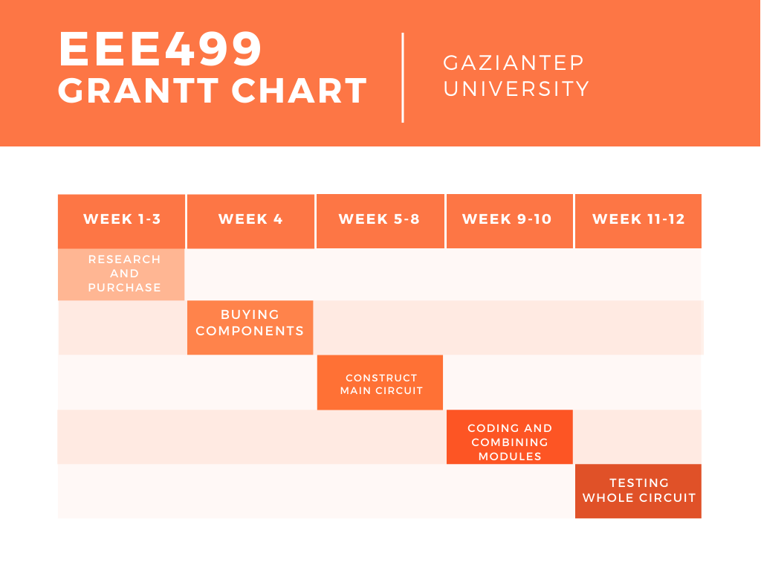

Slide 24
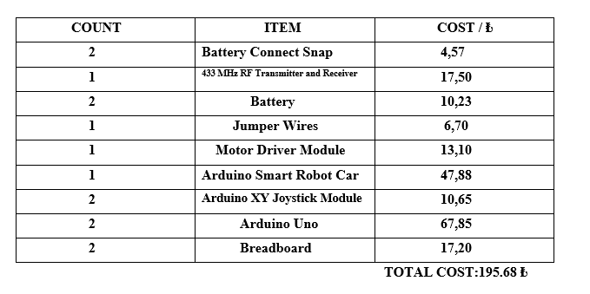
BUDGET OF PROJECT

Slide 25
CONCLUSION
Communication systems play an important role in maintaining communication between people or organizations or institutions, or even in getting people to receive entertainment programs or news or other television or radio broadcasting programs through wired or wireless communication systems. Similarly, in this project I made a wirelessly controlled robot that is controlled using radio frequency technology with Arduino. By realizing this project, this system essentially wanted to help people who want to control indoor air quality with an affordable budget and ease of use.

Slide 26
REFFERENCES
https://maker.pro/custom/tutorial/how-to-make-a-radio-controlled-robot-introduction-to-rf-modules
https://circuitdigest.com/electronic-circuits/rf-controlled-robot-without-microcontroller
https://www.efxkits.us/radio-frequency-remote-controlled/
https://www.electronicshub.org/rf-controlled-robot-without-microcontroller/

Slide 27


